Slide 1
Product Catalog
Reham Hesham

Slide 2
Analysis – Required Packages
Use packages:
breeze
Livewire
Cart Package: darryldecode
Filament Admin Panel
Permission Package: Spatie
Media Library
Tailwind css

Slide 3
Analysis - Database
Tables
Users
Products – Categories - pivot
Reviews
Permissions “ in Package”

Slide 4
1.User Authentication with Roles:
1. Implement user registration and login using Laravel's authentication system. 2. Utilize roles and permissions to manage access rights. 3. Create roles like "Admin" and "User" with appropriate permissions.

Slide 5
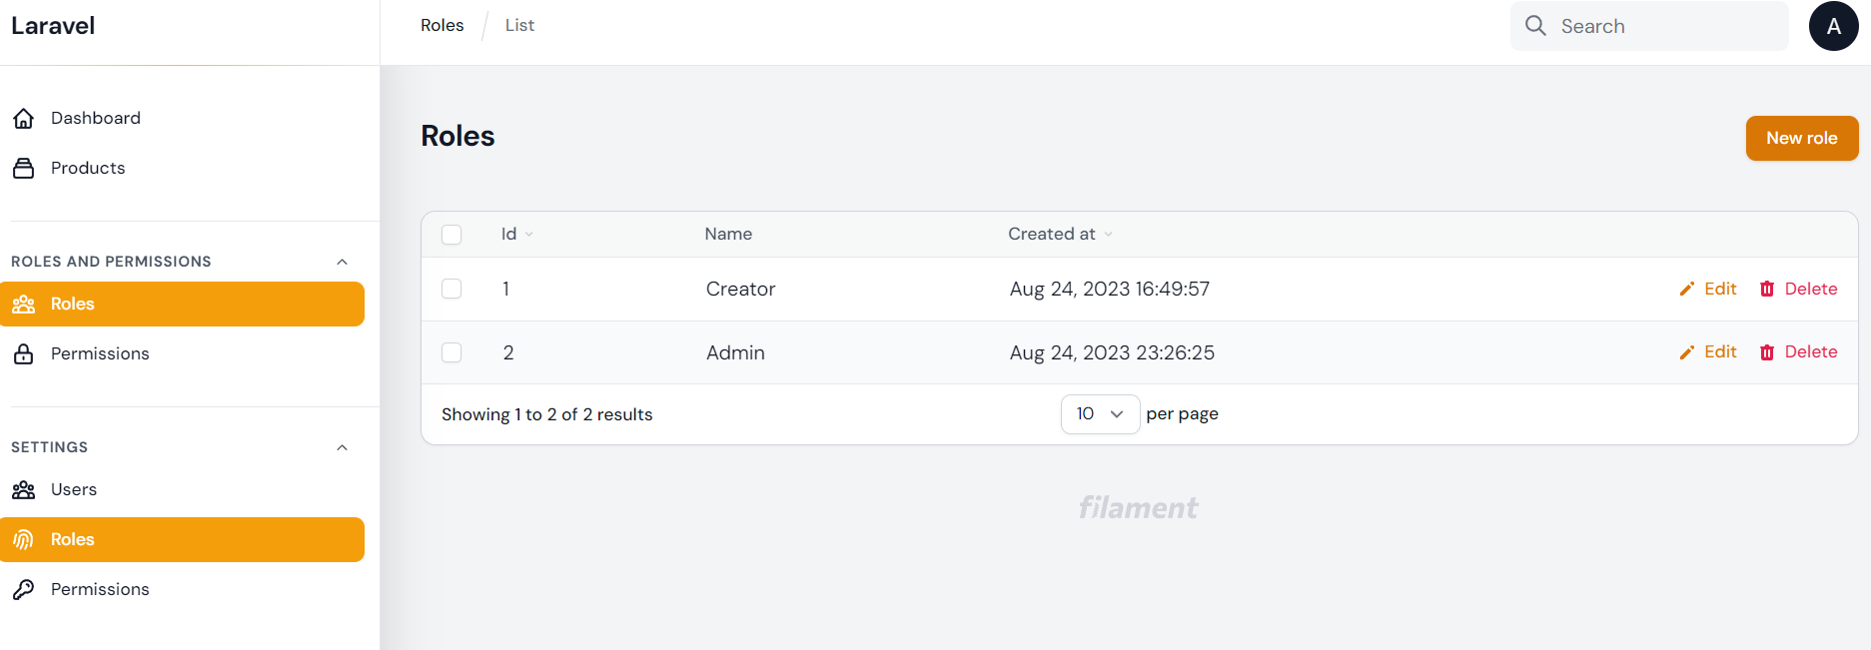
User Authentication with Roles
Breeze For Authentication
Spatie for Authentication
Manage Roles & permission from Dashboard
Use Policy to manage access right

Slide 6
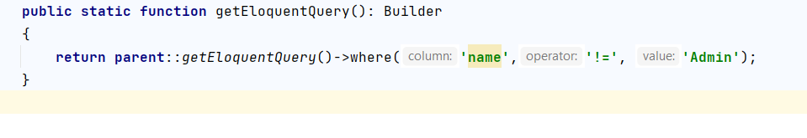
Rules
To make admin not appear in dashboard , use thus code in Role Resource of dashboard

Slide 7
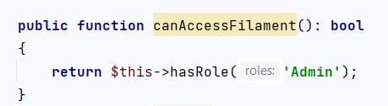
Rules
To make admin not appear in dashboard , use this code in Role Resource of dashboard
And to manage who access dashboard by default

Slide 8
2. Product Listing with Livewire:
Develop a dynamic product listing page using Livewire components.
Implement pagination for product listing to enhance user experience.
instead of normal pagination, you may go with infinite loading.

Slide 9
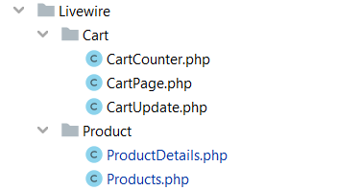
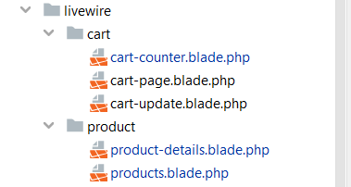
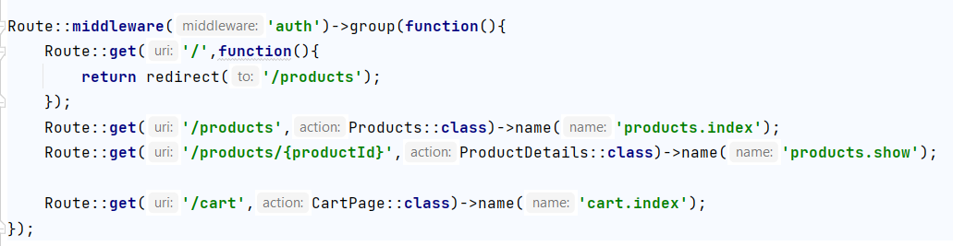
Main Components
Route for main file
Livewire Logic
Livewire blade

Slide 10
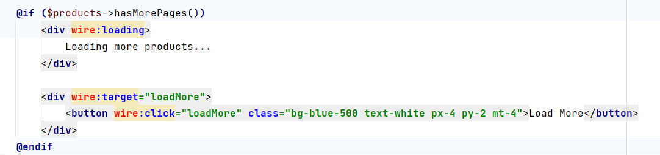
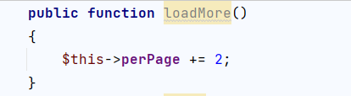

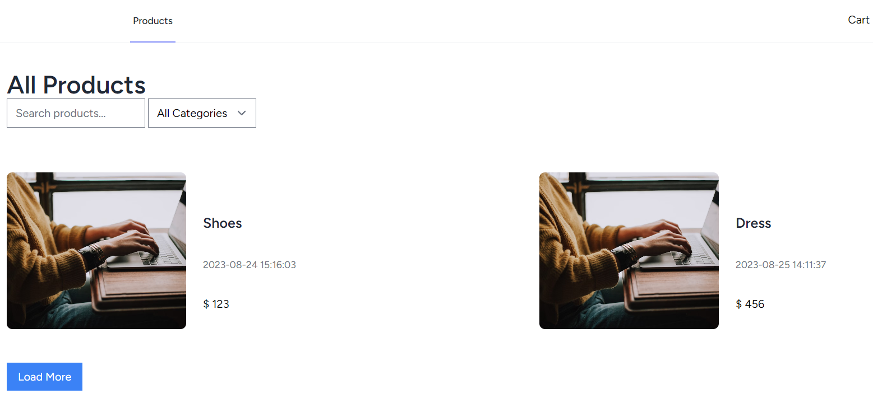
Products Load more

Slide 11
3. Product Details and Reviews:
Build a Livewire component for displaying product details.
Allow users to leave reviews and ratings for products.

Slide 12
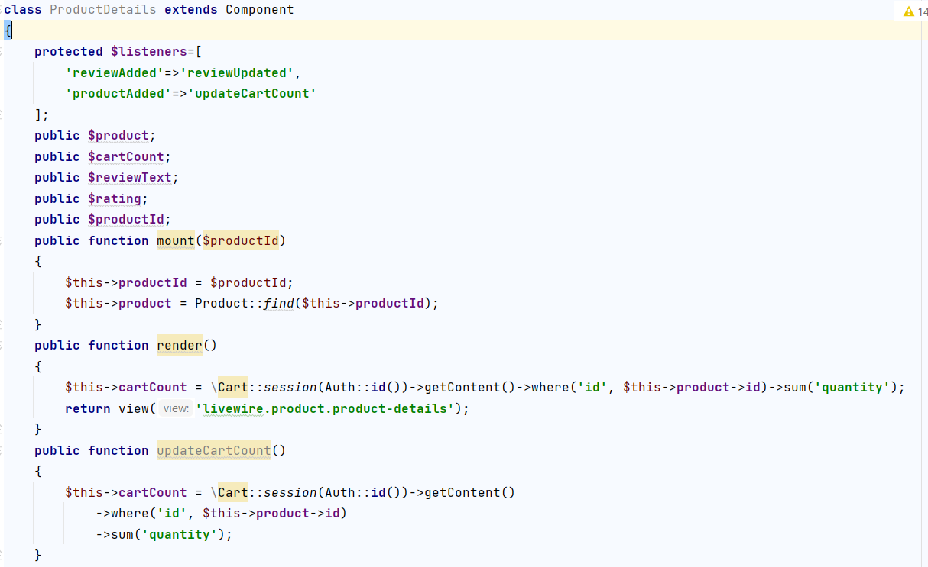
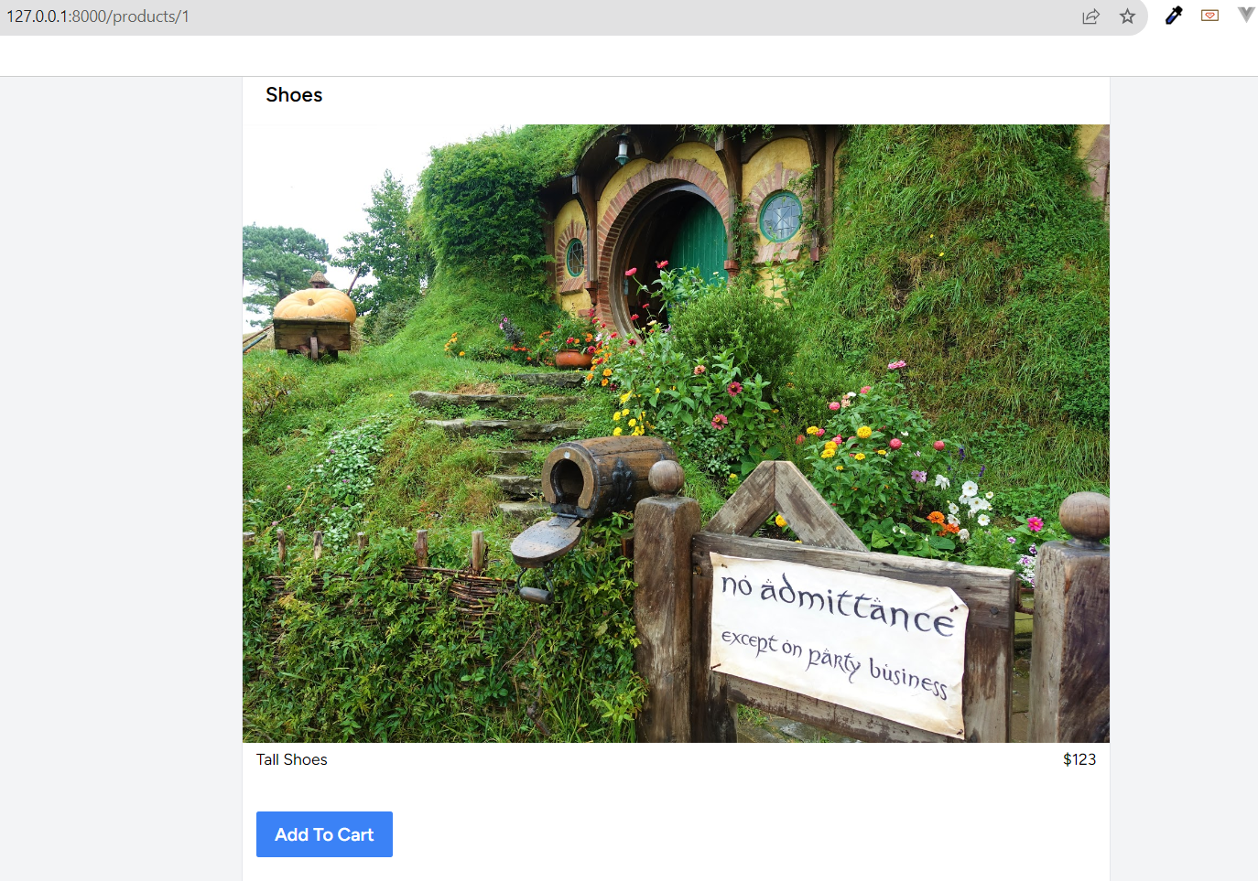
Product Details
Product details
Add To Cart “separated livewire page, connected with listener “

Slide 13
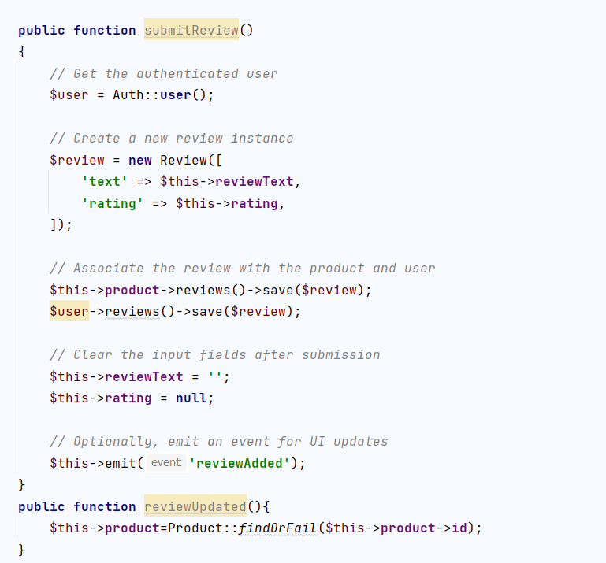
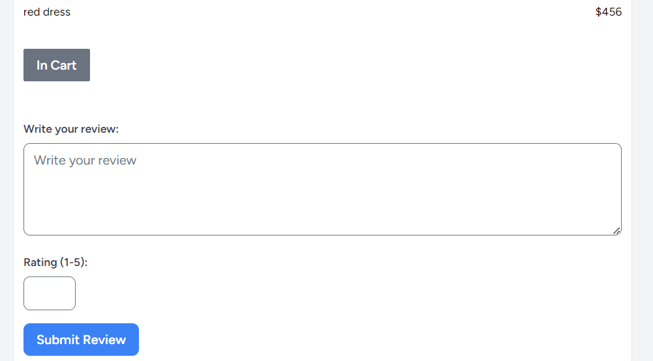
Product Reviews
Add rating and review of product

Slide 14
4. Instant Search and Filtering:
Implement a search feature.
Implement filtering options.

Slide 15
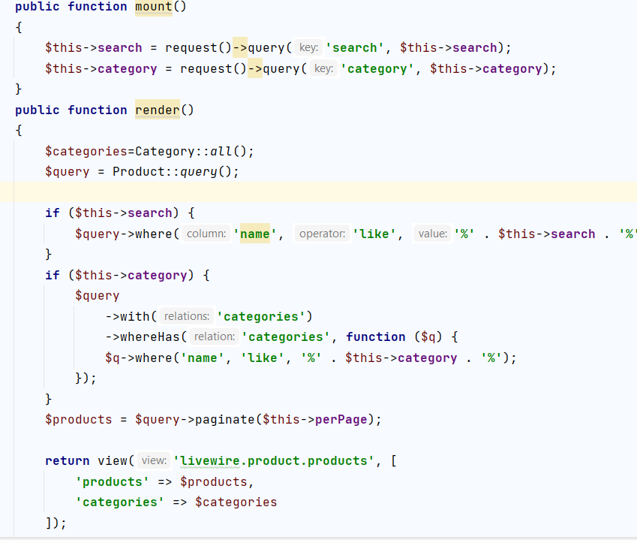

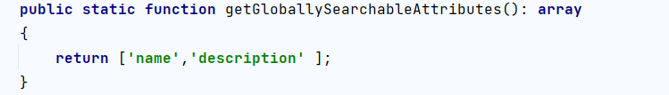
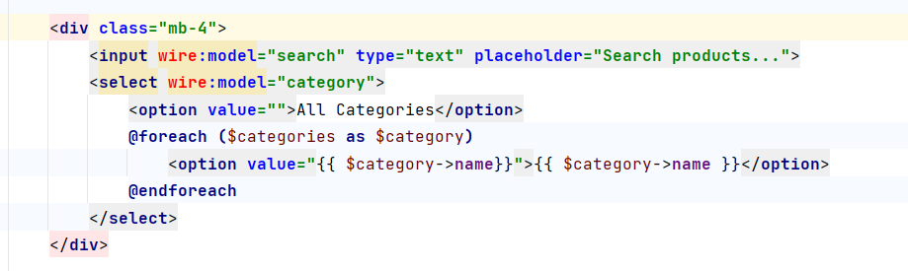
Search & Filter
Search and sort on admin panel “local , general”
Search on products page
Filter by category “select”

Slide 16
5. Shopping Cart with Livewire
Create a Livewire-powered shopping cart that updates
in real-time as users add or remove items.
2. Include quantity adjustments and total price calculations.

Slide 17
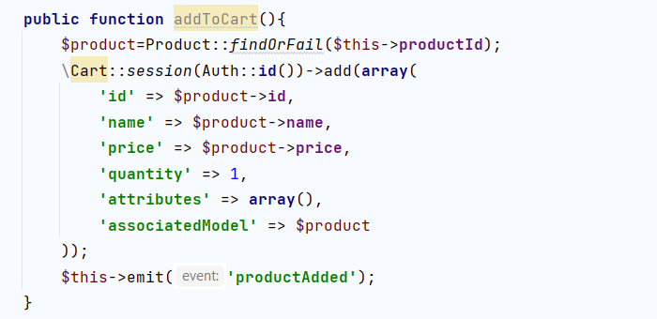
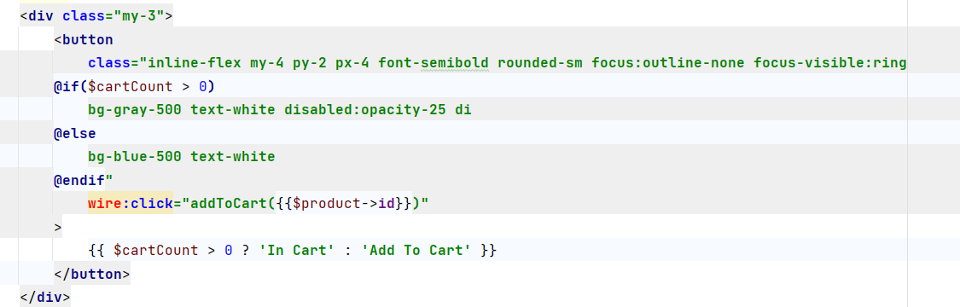
Cart _ add
bind button by wire:mode , and apply changes dynamically by wire:change

Slide 18
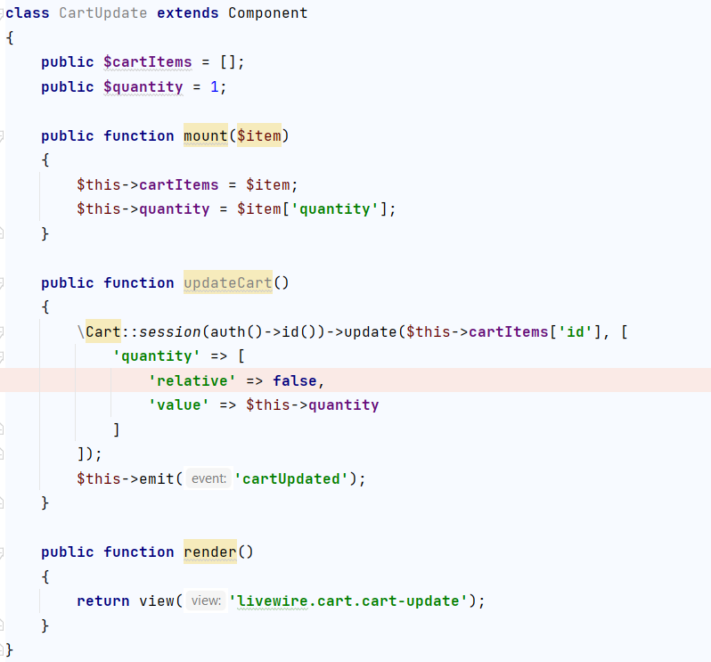
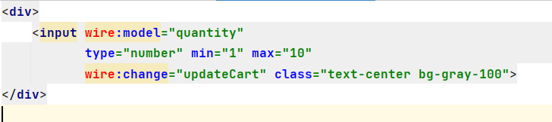
Cart _update
Make it as a separated page to handle quantity of targeted item
and emit event , and listen to it on cart page

Slide 19
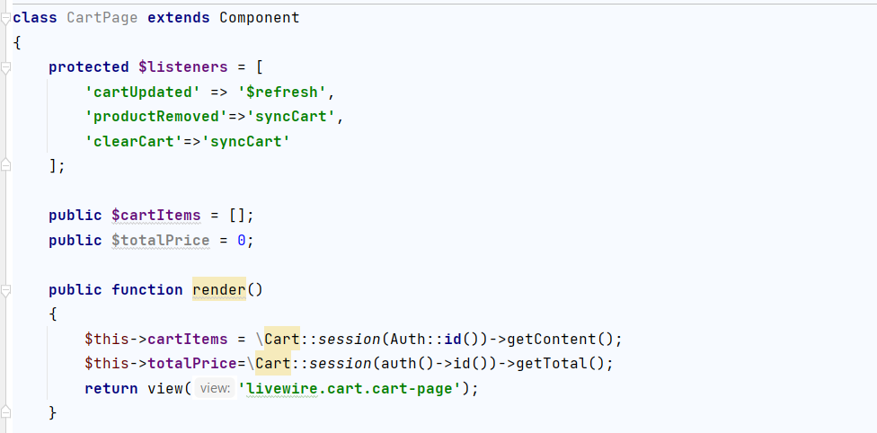
Cart _List
Cart Page have cart List
& function of remove item from cart

Slide 20
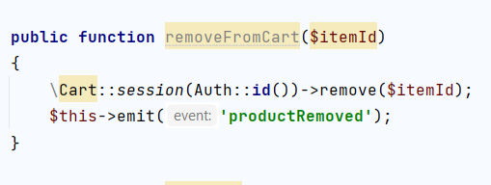
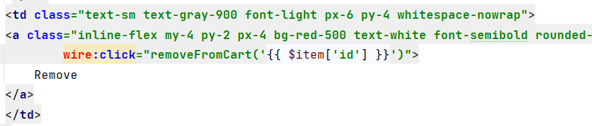
Cart _ Remove
Search and sort on admin panel “local , general”
Search on products page
Filter by category

Slide 21
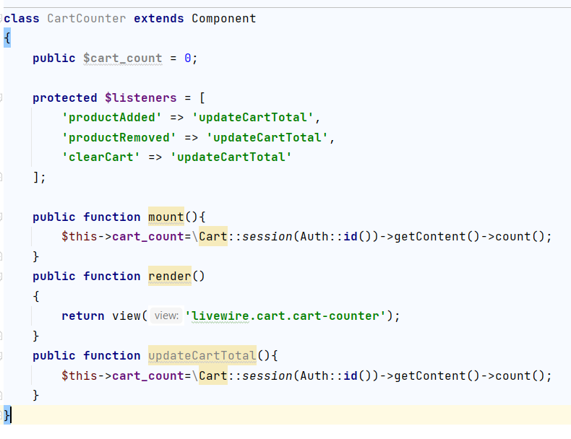
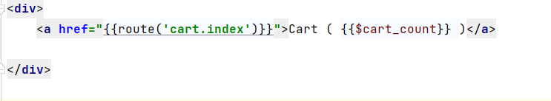
Cart _ Count
Get cart item
And updated it with all actions of cart

Slide 22
6. Admin Panel with Roles:
Design an admin panel with Livewire components for managing products.

Slide 23
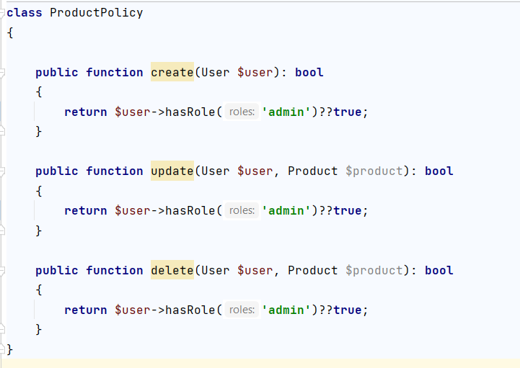
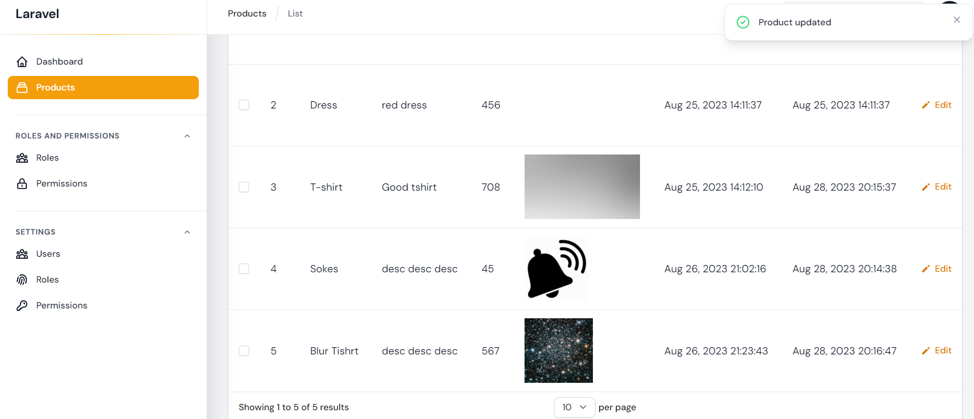
Admin Panel with Roles
Use policy for authorization

Slide 24
7. Exception Handling and Error Pages:
1. Implement an exception-handling system to
catch and gracefully display errors.
2. Create custom error pages for different error scenarios.

Slide 25
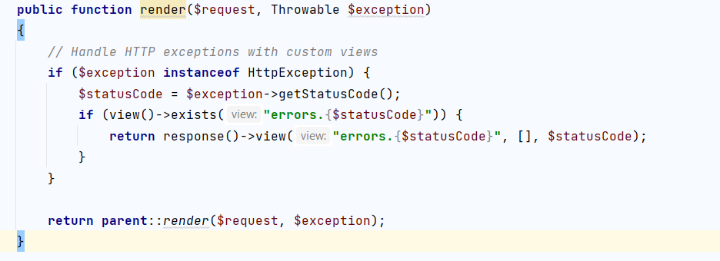
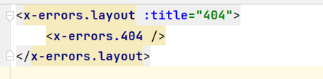
Admin Panel with Roles
Exception handling
we can implement error page from scratch
And we can publish error pages and edit them

